Slide 1



DCV KPI
Last data refresh:
03/11/2022 19:43:01 UTC
Downloaded at:
03/11/2022 19:44:48 UTC

Slide 2
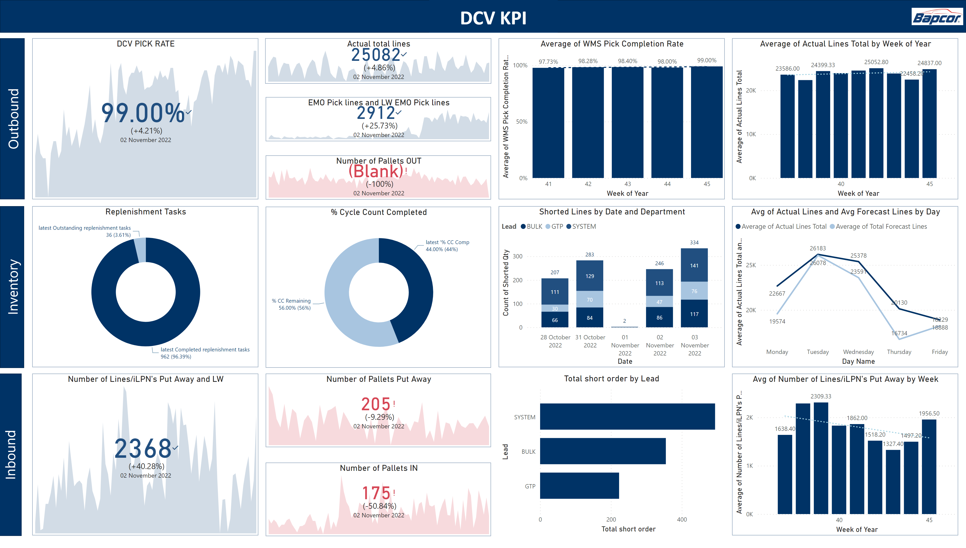
Dashboard
Notes:
card
No alt text provided
shape
No alt text provided
shape
No alt text provided
shape
No alt text provided
shape
No alt text provided
image
No alt text provided
DCV PICK RATE
No alt text provided
Replenishment Tasks
No alt text provided
Number of Pallets IN
No alt text provided
EMO Pick lines and LW EMO Pick lines
No alt text provided
Number of Lines/iLPN's Put Away and LW
No alt text provided
Number of Pallets Put Away
No alt text provided
Number of Pallets OUT
No alt text provided
Actual total lines
No alt text provided
% Cycle Count Completed
No alt text provided
Average of WMS Pick Completion Rate
No alt text provided
lineClusteredColumnComboChart
No alt text provided
Avg of Number of Lines/iLPN's Put Away by Week
No alt text provided
Shorted Lines by Date and Department
No alt text provided
Avg of Actual Lines and Avg Forecast Lines by Day
No alt text provided
clusteredBarChart
No alt text provided

Slide 3
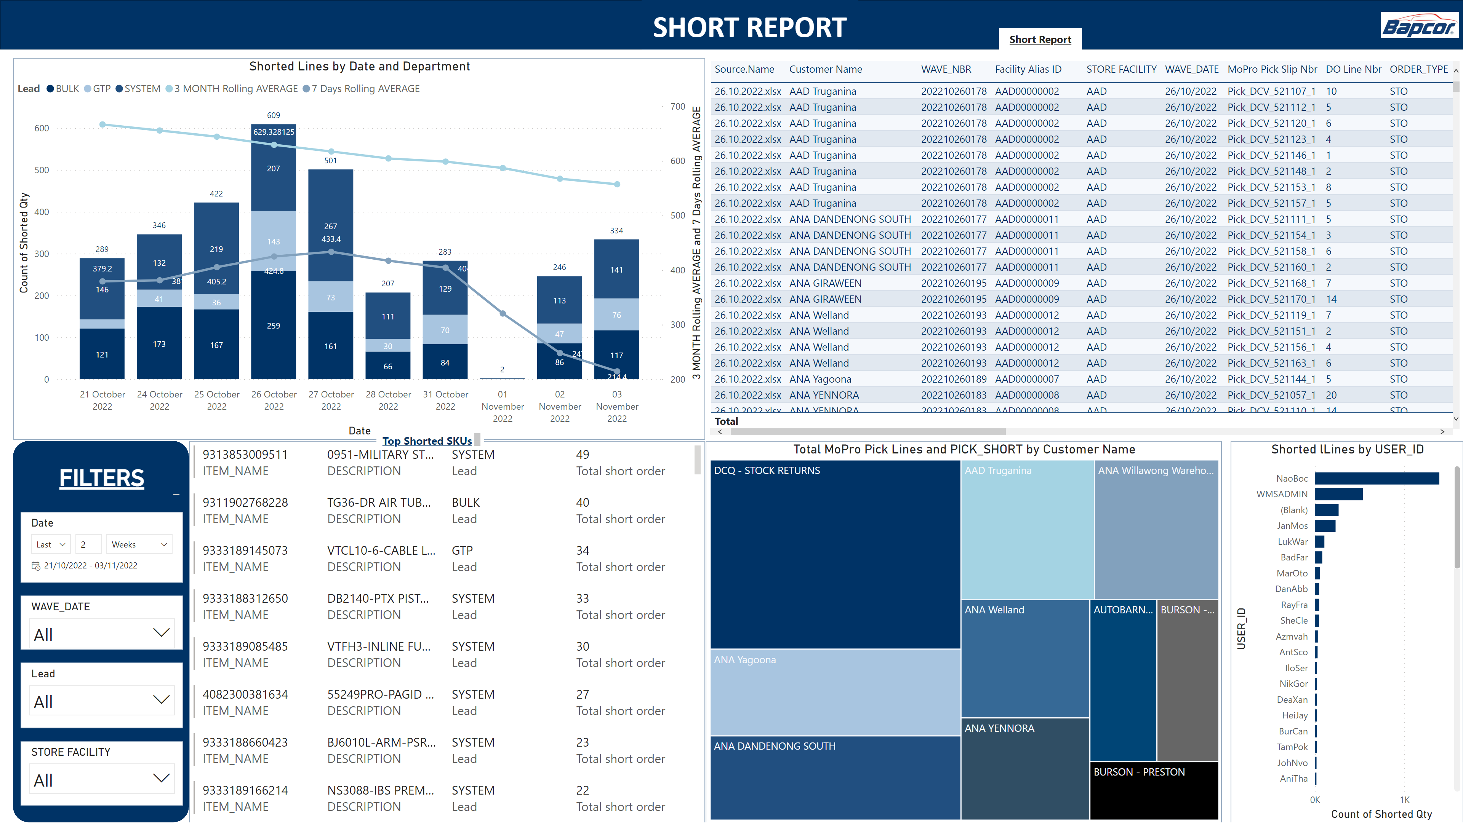
Short report
Blurred Data
Blurred Data
Notes:
card
No alt text provided
shape
No alt text provided
image
No alt text provided
slicer
No alt text provided
Shorted Lines by Date and Department
No alt text provided
Shorted lLines by USER_ID
No alt text provided
multiRowCard
No alt text provided
Total MoPro Pick Lines and PICK_SHORT by Customer Name
No alt text provided
slicer
No alt text provided
slicer
No alt text provided
textbox
No alt text provided
tableEx
No alt text provided
slicer
No alt text provided
textbox
No alt text provided
shape
No alt text provided
FILTERS
No alt text provided

